Slide 1
Biofuel Group Tech Review
Renlong Zheng
Jingtian Zhang
Cheng Zeng
Chenggang Xi

Slide 2
Background
QSPR studies are aimed at developing correlation models using a response of biofuels (property) and chemical information data in a statistical approach
Molecular structures descriptors can be extracted from DIPPR database.
Thermal properties can be found in Materials Studio/Aspen plus/several papers.
Classification-based approaches are employed when categorization of the data points into several groups or classes such as highly active and less active.
The regression-based methods enable the quantitative prediction of the response (activity/property), while classification methods allow categorization of the data points into several groups or classes such as highly active and less active.
Notes:
Chose data column_ t_testing
Different family _ classification/graph
In one type of family _ regression

Slide 3
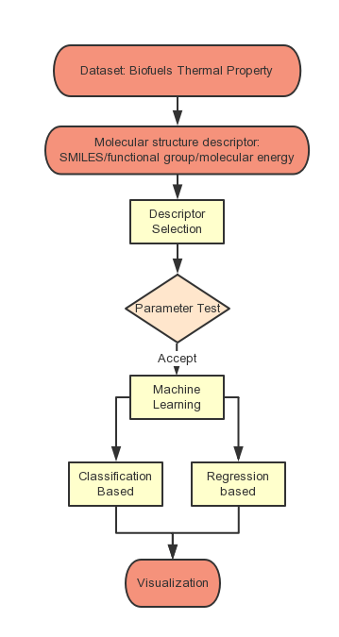
Typical Workflow for QSPR / QSAR Machine Learning
Notes:
The OECD principles are the best possible outline of the essential points to be
addressed while developing reliable and reproducible QSAR models
• Principle 1—A defined endpoint
• Principle 2—An unambiguous algorithm
• Principle 3—A defined domain of applicability
• Principle 4—Appropriate measures of goodness-of-fit, robustness and
predictivity
• Principle 5—A mechanistic interpretation, if possible.

Slide 4
Methods will be used
Statistical approaches correlating the response properties with descriptors encoding chemical information (Machine Learning)
Regression-based chemometric tools
Multilinear Regression (MLR)
Partial Least Squares (PLS)
Classification-based chemometric tools
Linear Discriminant Analysis (LDA)
Cluster Analysis (CLA)
Other approaches
Graph machine method(SMILE)
Parameter test(T-testing)
Notes:
graph machine method
simplified molecular input line entry specification (SMILES) formulas

Slide 5
Classifier Machine Learning: LDA
Linear discriminant analysis (LDA)
DF =C1*X1+C2*X2+......+Cn*Xn+a
LDA explicitly intends to model the differences between models of data
DF is the discriminant function, which is a linear combination (sum) of the discriminating variables
c is the discriminant coefficient or weight for that variable
X is respondent’s score for that variable
a is a constant
m is the number of predictor variables.
The c’s are unstandardized discriminant coefficients analogous to the beta coefficients in the regression equation
sklearn.discriminant_analysis.LinearDiscriminantAnalysis( )
Notes:
These c’s maximize the distance between the means of the criterion (dependent) variable.
Good predictors tend to have large standardized coefficients.
After using an existing set of data to calculate
the DF and classify cases, any new cases (test samples) can then be classified.

Slide 6
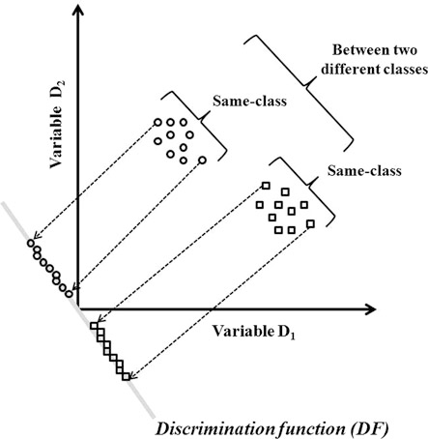
Classifier Machine Learning: LDA

Slide 7
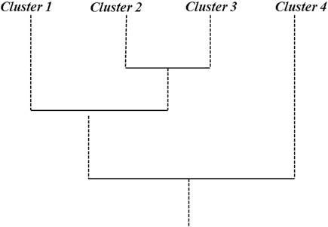
Classifier Machine Learning: Cluster
Cluster Analysis
Do not require to know elements belong to which cluster
Cluster analysis maximizes the similarity of cases within each cluster while maximizing the dissimilarity between groups that are initially unknown.
There are many types
Connectivity based
Centroid based
Distribution based
Density based

Slide 8
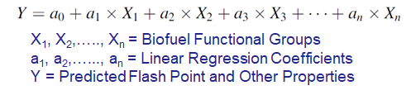
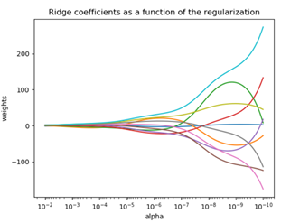

Multilinear Regression
Multiple Linear Regression (MLR):
Ridge
LASSO
To determine the adjustable parameter 𝝀, we observed the significant of each regression coefficient at P < 0.05.

Slide 9
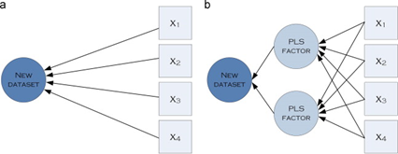
Multilinear Regression Contd.
Partial Linear Square Regression (PLS):
It involves secondary components, PLS Factors
As the number of PLS Factor increases, PLS regression become the same as MLR

Slide 10
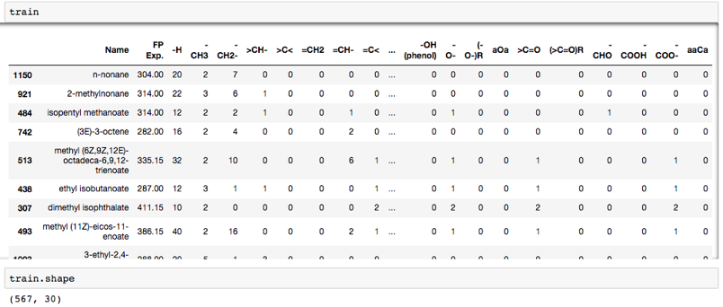
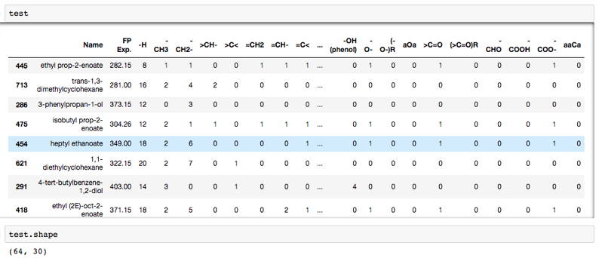
Eg. Data → Training and Testing
Testing data

Slide 11
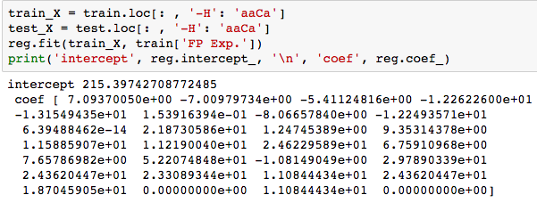
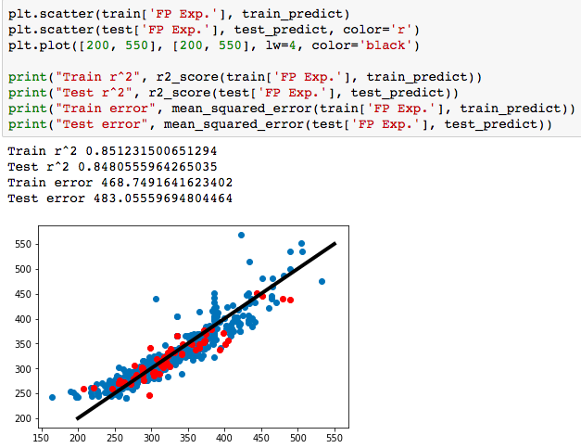
Multiple Linear Regression
Ordinary Least Squares (Use all functional groups as descriptors)
Each regression coefficient should be significant
at p < 0.05 which can be checked from a ’t’ test.

Slide 12
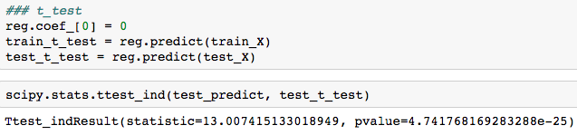
T-test
The null hypothesis: reg.coef_[0] = 0
P value < 0.05
So the null hypothesis is rejected,
reg.coef_[0] != 0
The first descriptor is significant to the relation.
Next step:
Iterate, iterate, iterate

Slide 13
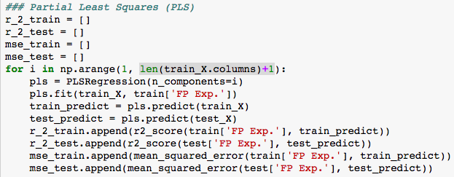
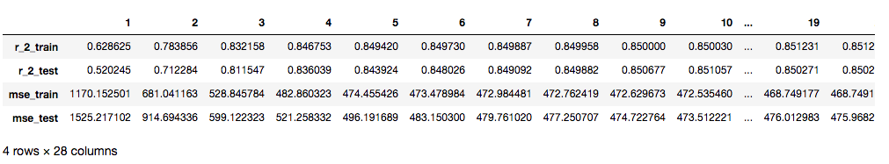
Partial Least Squares (PLS) (Choose components to decide descriptors)
It seems when descriptors increase, the r_2 becomes larger, and mse becomes smaller.
When descriptors are larger than 5, the prediction seems stable.

